Slide 1



Custom LCD Characters:
Implemented on Altera DE2 Board
Juan Calderin
Michael Dean
Florida State University
Electrical and Computer Engineering Department
EEL4930 - Embedded Microprocessor System Design
Final Project Presentation

Slide 2

Outline
  Project Outline
  - Description
  - Experimental Setup
  - Approach: Literary review
  & Gantt Chart
  Research & Development
  - LCD Overview
  - LCD Controller
  - LCD Functions
  - Interfacing with the LCD
  using the Hardware Abstraction Layer (HAL) and Altera API
  - LCD Initialization
  - Display Data RAM (DDRAM)
  - Character Generator ROM (CGROM)
  - Character Generator RAM (CGRAM)
  Limitations and Suggested Future Developments
  Conclusion
JC

Slide 3

Project Description
  Implement custom
  designed LCD characters such
as copyright © or Greek πα∑
  The software was written in
  "C" and utilizes a SoPC
  architectural design
MD

Slide 4
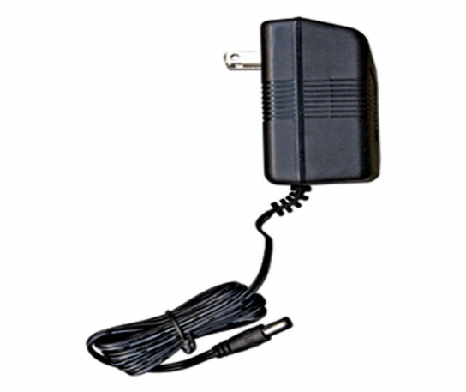
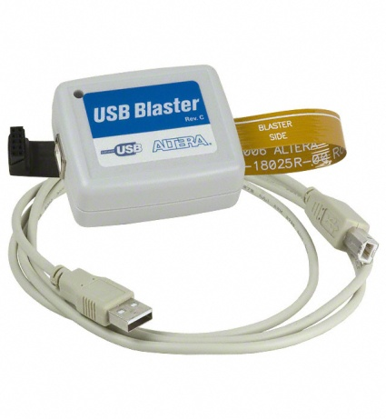
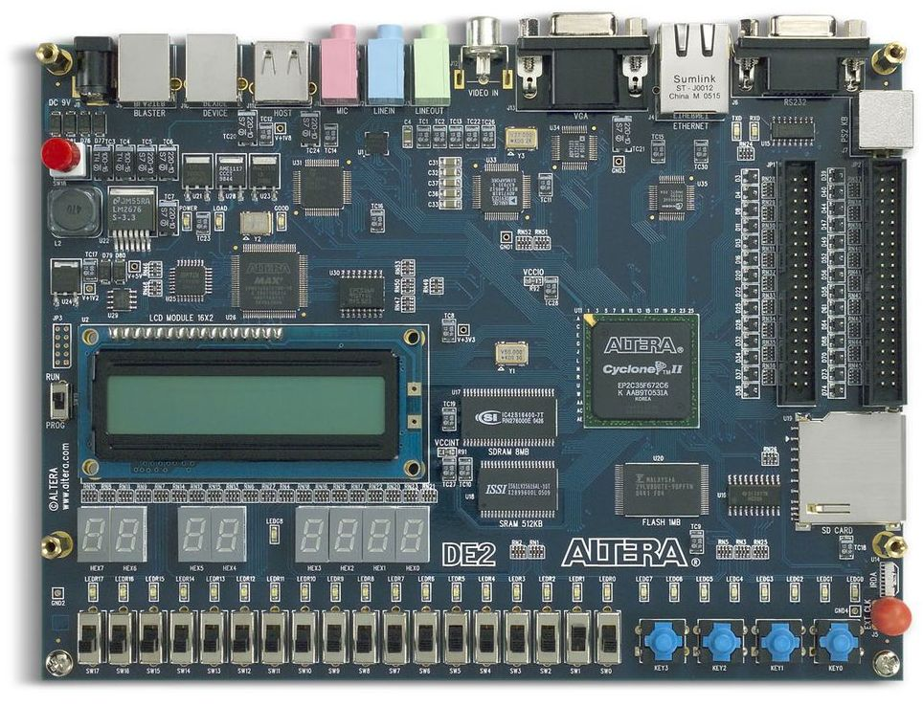
Experimental Setup:
Hardware
Utilized Hardware:
  Altera DE2 Board with Cyclone II FPGA
  16 character x 2 line STN LCD Display
  USB Blaster Port for Code download to board from computer
  9V DC Power Supply for board
MD

Slide 5

Experimental Setup:
Hardware Setup
  Reset switch is set to switch 6
  The other switches can be set
  to select which character to
  display.
  Switch 9 must be set in the on
  position since it is the default
  reset switch for the board
MD

Slide 6
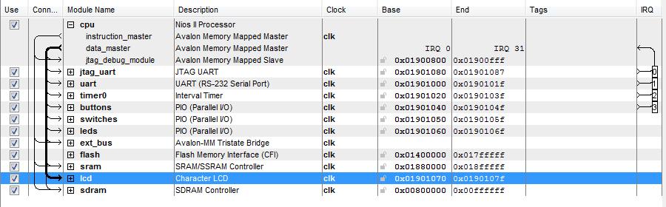
Experimental Setup:
Software
  SoPC design was created using SoPC
  builder
  The software code was written in C
JC

Slide 7
Approach:
Literary Review
  LCD Data Sheet (Crystalfontz
  America, Inc)
  Nios II IDE Developer Manual
JC

Slide 8
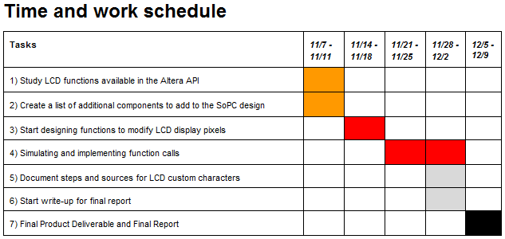
Approach:
Gantt Chart
  This is the projected schedule for
  researching and completing the
  software code and creating
  custom LCD characters.
MD

Slide 9
Research and Development:
LCD Overview
  Number of Chacters:
16 Chacters x 2 Lines
  Module Dimension:
80 x 36 x 13.5 mm
  View Area:
66 x 16 mm
  Active Area:
56.2 x 11.5 mm
  Character Size:
2.95 x 5.55 mm
  LCD Type:
Super-twisted Nematic (STN), Negative, Transmissive,
Blue
MD

Slide 10
Research and Development:
LCD Controller
  Optrex 16207 LCD Controller
  Two 8-bit registers
  - Instruction Register (IR)
  - Data Register (DR)
  The IR stores the instruction
  codes (display, clear ...)
  The DR temporarily
  stores data to be written
  or read from DDRAM or CGRAM.
  The Register Selector (RS) selects the IR or DR
  Read/Write (RW) signal
JC

Slide 11

Research and Development:
LCD Functions
  Functions are selected by sending
  values to RS, R/W, and LCD Data ports (DB7 - DB0)
  We were interested in only two modes, command mode and
  writing mode
  Command Mode
  - RS = 0
  - RW = 0
  Writing Mode
  - RS = 1
  - RW = 0
JC

Slide 12
Research and Development:
LCD Functions
  Clear Display
  Return Home
  Entry Mode Set
  Display On/Off Control
  Cursor or Display Shift
  Function Set
  Set CGRAM Address
  Set DDRAM Address
  Read Busy Flag and Address
  Write Data to CGRAM or DDRAM
  Read Data from CGRAM or DDRAM
MD

Slide 13
Research and Development:
Interfacing With the LCD Using the HAL System Libraries
  The HAL System Libraries and the Altera API allow us to easily interface with the LCD using pre-existing C functions.
  IOWR(BASE, REGNUM, DATA)
  BASE: Address of the device
  REGNUM: RS and R/W
  DATA: DB7-DB0
JC

Slide 14
Research and Development:
LCD Initialization
  Initialize LCD as 8-bit, 2 line, 5x7 mode
  DATA = 0x38
  Cycle Display (OFF/ON)
  DATA = 0x08
  DATA = 0x0C
  Set Entry Mode
  DATA = 0x06
  Set Cursor to Home position
  DATA = 0x02
  Clear Display
  DATA = 0x01
  *Remember that DATA = DB7 to DB0
JC

Slide 15
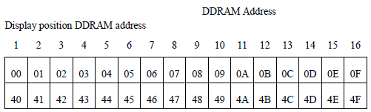
Research and Development:
Display Data RAM (DDRAM)
  This value is used to
choose which spot on the
LCD screen will be written
  The starting address for
the DDRAM starts at $00
and goes to 0F on the
first line and from
40 to 4F on the
second line
//used when in command selection mode
#define LCD_WR_COMMAND_REG 0
//used when writing to RAM
#define LCD_WR_DATA_REG 2
// set ddram address (position on the screen)
IOWR( LCD_BASE, LCD_WR_COMMAND_REG, 0x80 + pos );
usleep(100);
MD

Slide 16
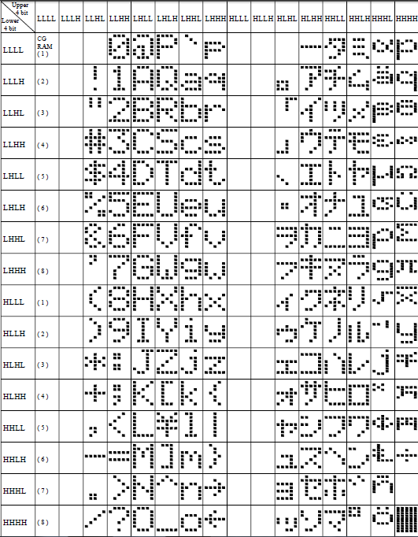
Research and Development:
Character Generation ROM
  The CGROM is where
the custom and built in
character codes are
stored on the
CGROM Table
MD

Slide 17
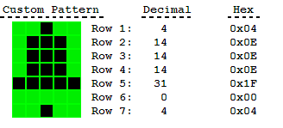
Research and Development:
Character Generation RAM
  The CGRAM is where the
5 x 8 display light pattern
is set for a custom character
  After an address is selected
the lights of the 8 rows can
be turned on by assigning
values $00 to $1F
// set cgram address to 00
IOWR( LCD_BASE, LCD_WR_COMMAND_REG, 0x48 + (pos * 8) );
usleep(10000);
JC

Slide 18
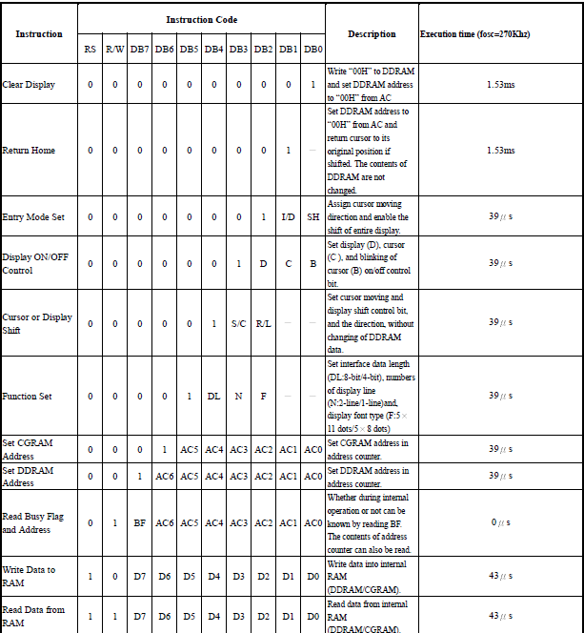
JC
Instruction Table

Slide 19
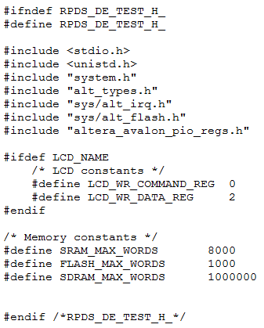
Header File

Slide 20
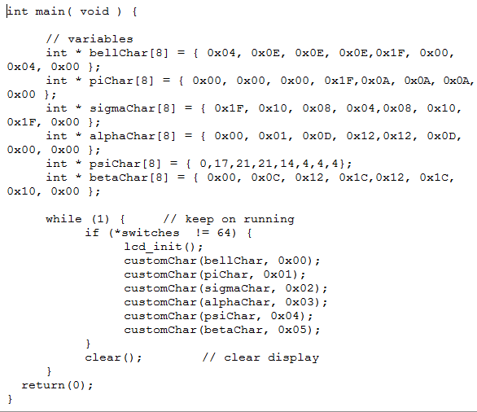
Main Function

Slide 21
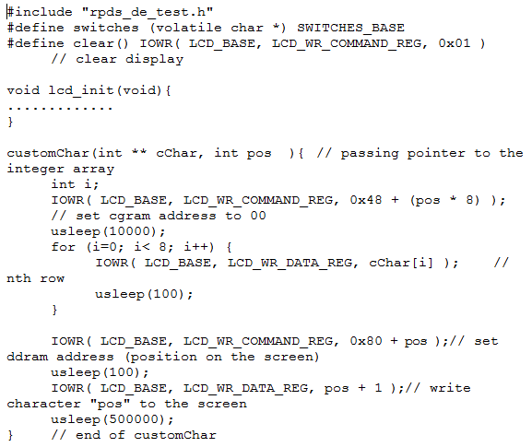
Function Definitions

Slide 22
Limitations and Suggested future developments
  Limitations
  - There is a limit on the amount of
  custom characters that can be
  stored in the CGRAM
  - Complex characters are
  harder to "draw"
  Future Developments
  - Custom Fonts
  - Foreign Language Alphabets
JC

Slide 23
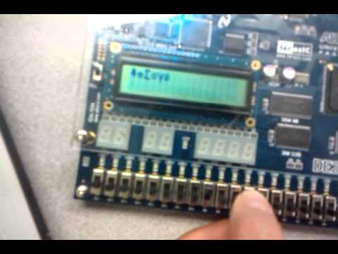
Conclusion
This project was very helpful in
understanding how to control
the LCD at a hardware
level.
We then learned how to utilize the
IOWR functions to display our
custom characters.
MD

